Slide 1




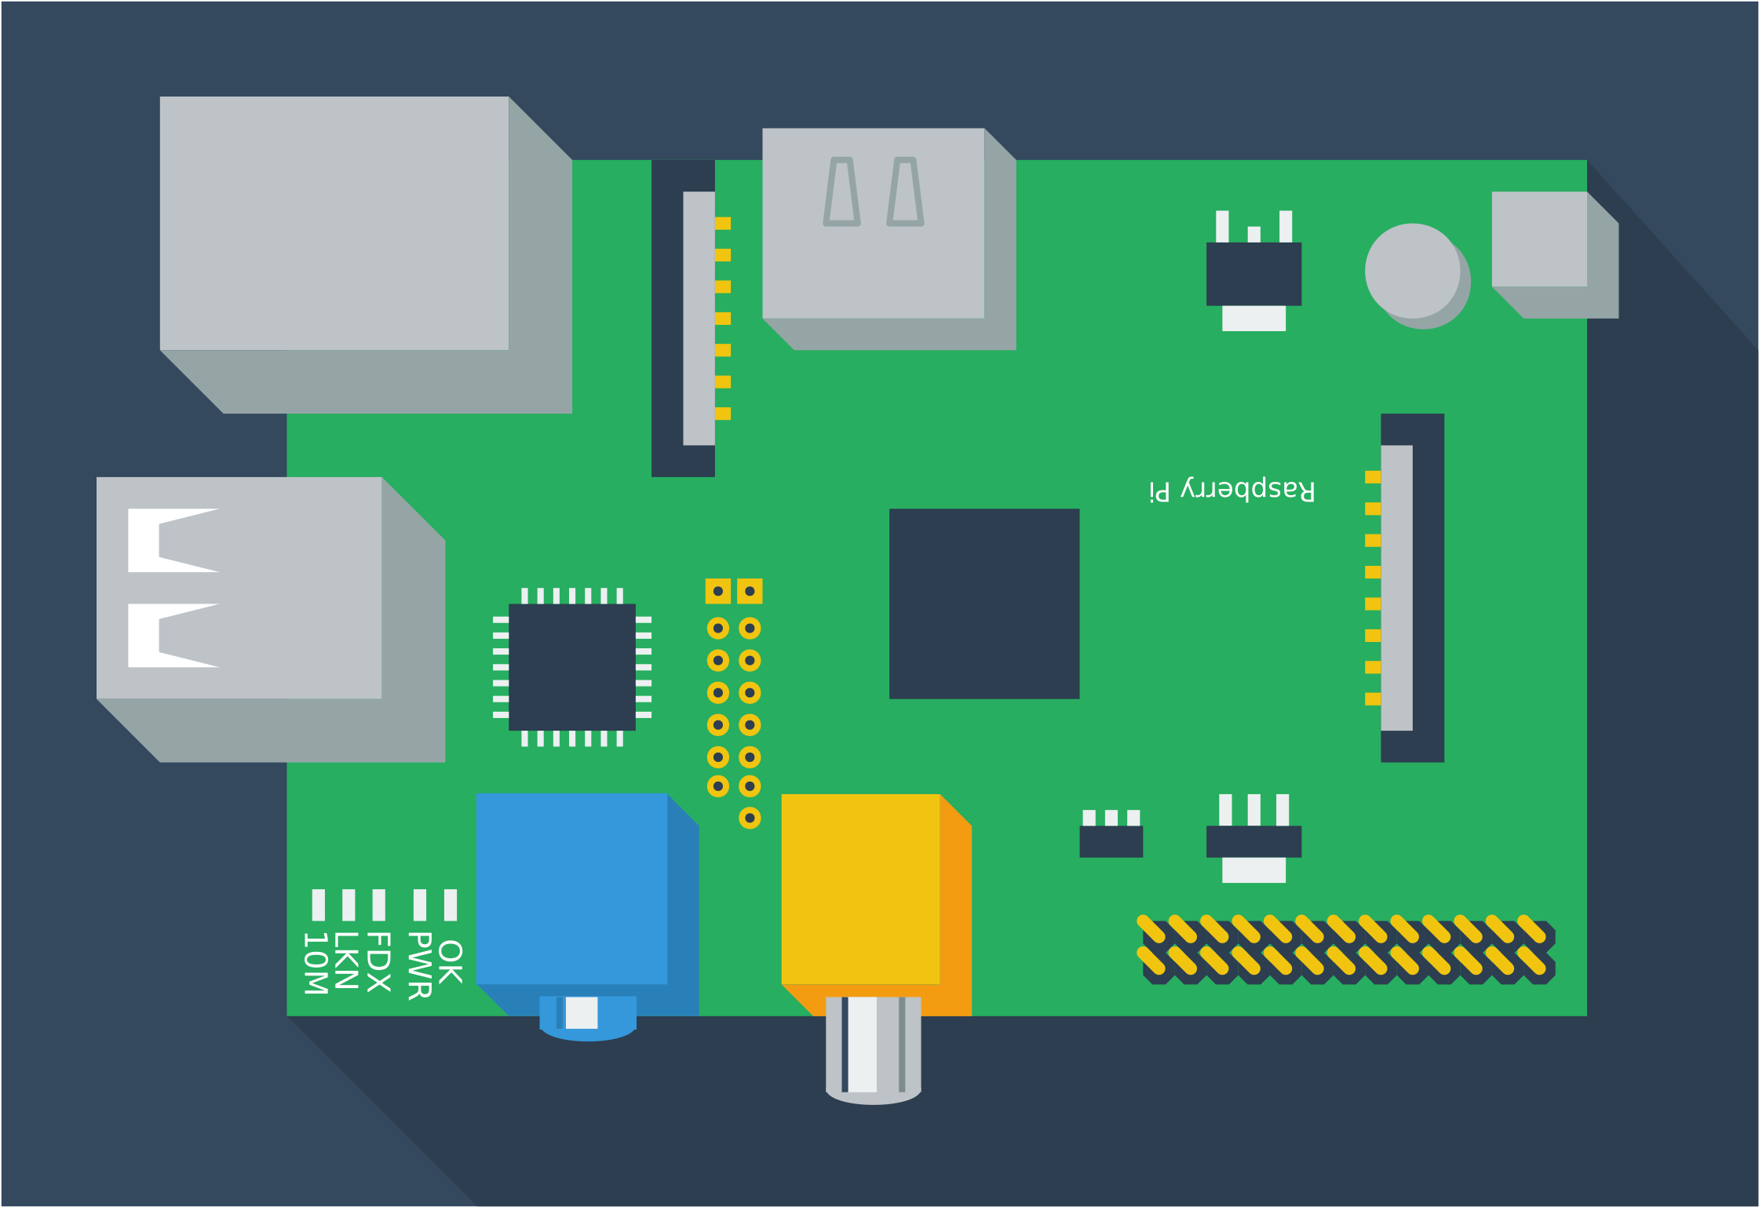


MQTT on Pi
NOV 2021
Safyzan Salim
scriptworkz ent

Slide 2
MQTT on Pi – Let’s Start
Scenario
You have been assigned to monitor the temperature and moisture of a server room. The results can be monitored anywhere. Your system must be able to capture 2 server racks’ temperature and humidity, and also the server room’s temperature and humidity too.
Future Project >>A notification alarm will be activated if the any of the sensors passes the certain condition, e.g., rack temperature greater than 25°C, or server room’s temp too high… etc.
SZS - Nov 2021

Slide 3
MQTT on Pi – Let’s Start
Prerequisites
Hardware:
Raspberry Pi board with:
-Raspberry Pi OS
-16 GB class 10 microSD
-5V 2.5A power supply
ESP32 with Temperature & Humidity Sensor, DHT11**
Software:
Node-RED
Arduino IDE
Arduino Client for MQTT library
Aedes MQTT
WiFi:
A 2.4G AP
** This project uses Grove - Temperature & Humidity Sensor (DHT11)
https://mqtt.org
SZS - Oct 2021

Slide 4
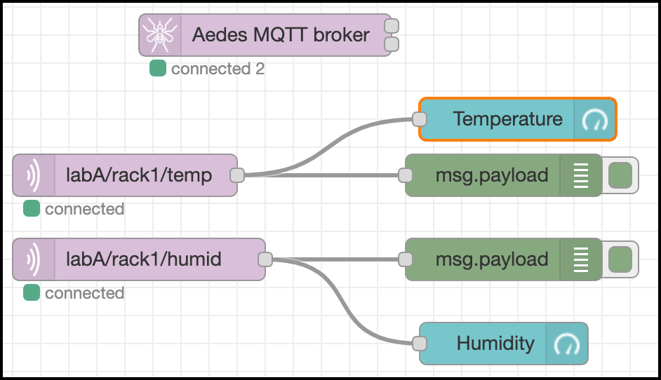
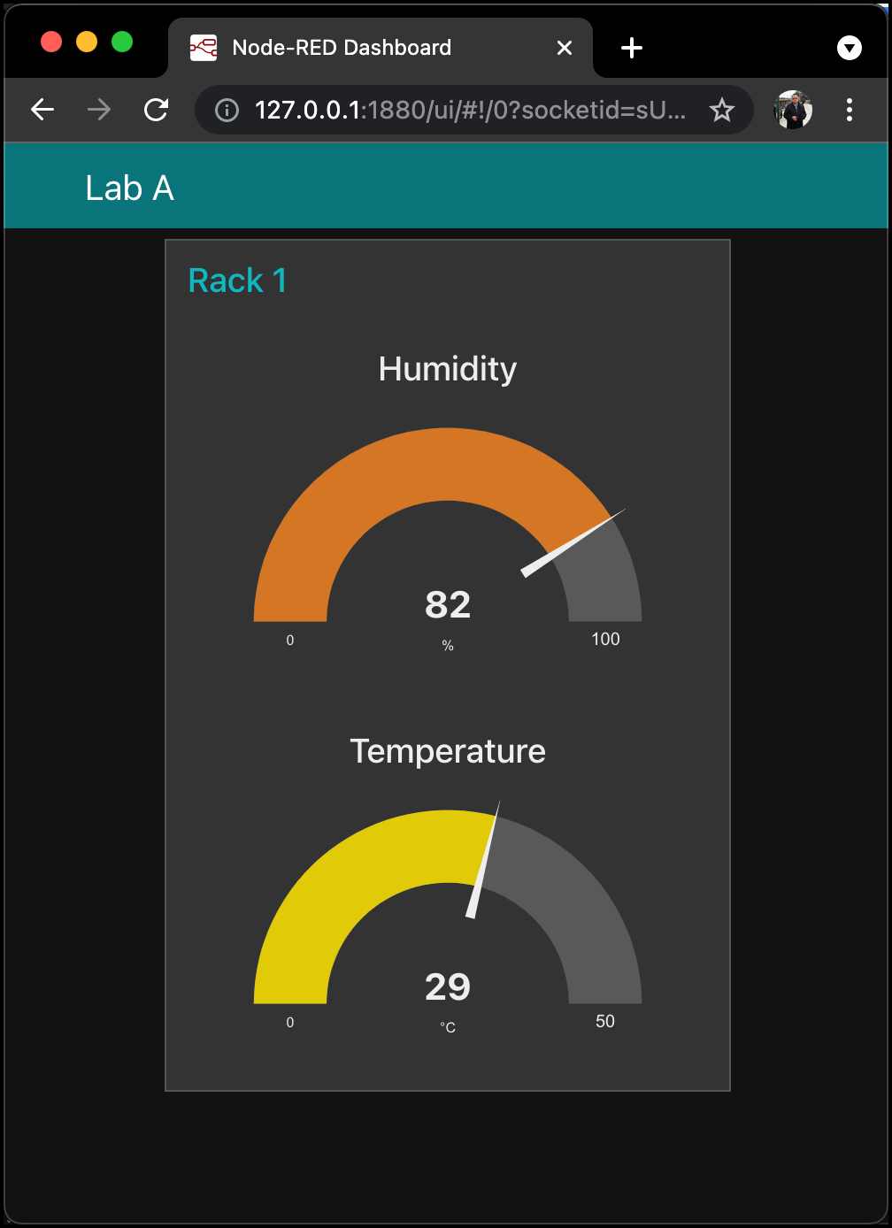
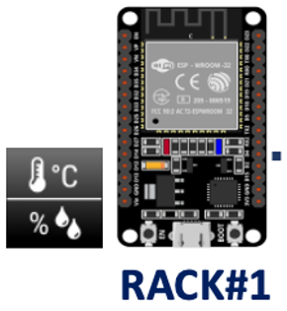
MQTT on Pi – Let’s Start
How It Works
ESP32 & DHT11 will be fixed at a rack, named Rack#1 at Lab A. Aedes broker is running on a Raspberry Pi (PC/Laptop/Mac).
After connected to WiFi, data from ESP32 will be sent to broker.
Since the Node-RED has subscribed topic labA/rack1/temp & labA/rack1/humid from ESP32, both information (temp & humid) will be displayed at debug & also gauges – in real time.
Raspberry Pi / Laptop / Desktop – Cross Platform
SZS - Nov 2021

Slide 5

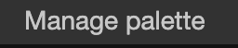
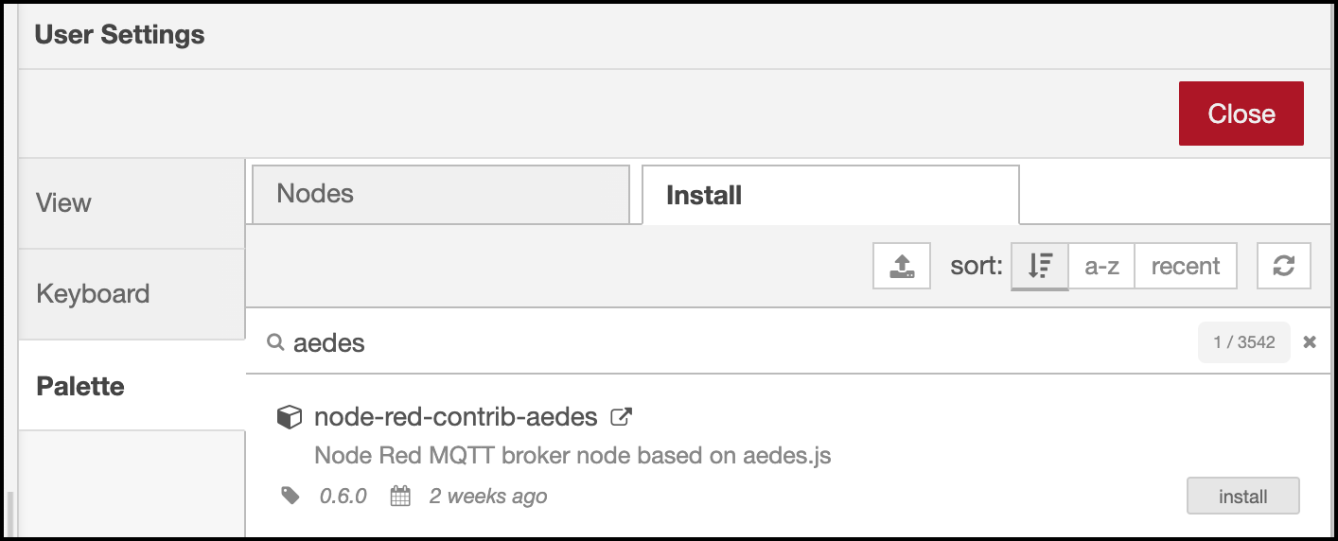
MQTT on Pi – Let’s Start
i. Install & Run Aedes Broker Service
Execute Node-RED service.
Install Aedes broker by clicking:
Node-RED Menu > Manage palette > Install > type aedes at search module > node-red-contrib-aedes > install
Type aedes
Click install
Wait & make sure the install button changed to installed.
SZS - Oct 2021

Slide 6

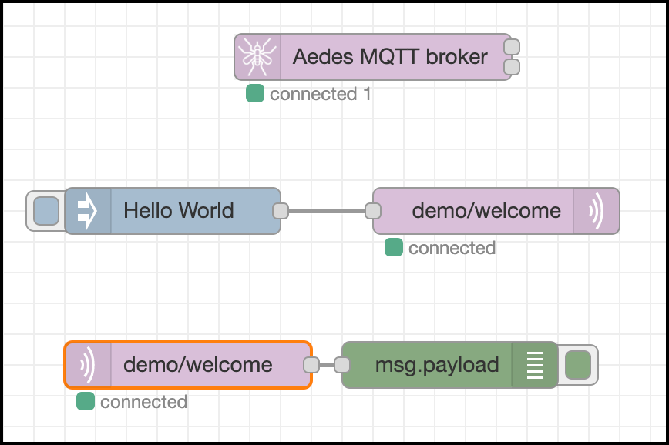
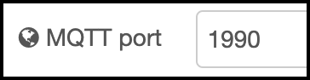
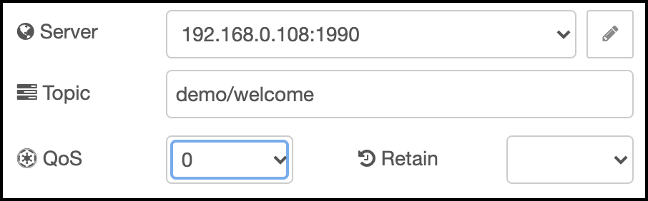
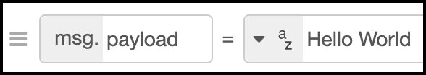
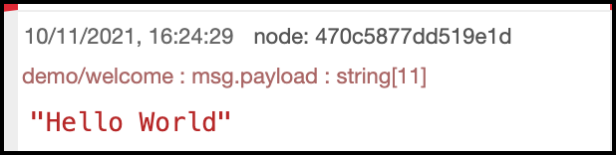
MQTT on Pi – Let’s Start
ii. Test Aedes Broker Service
Setup as in the figure.
Configurations:
BROKER IP = 192.168.0.108*
MQTT port = 1990 **
Topic = demo/welcome
Download: https://bit.ly/3olPfcE
* Please check your device IP address.
** Do not use 1880 – reserved to localhost:1880
SZS - Nov 2021

Slide 7
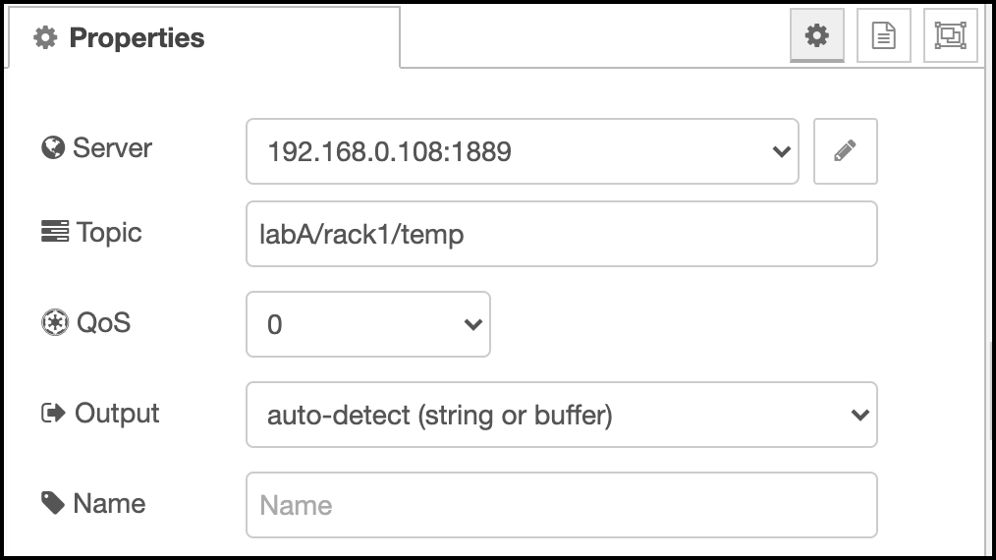
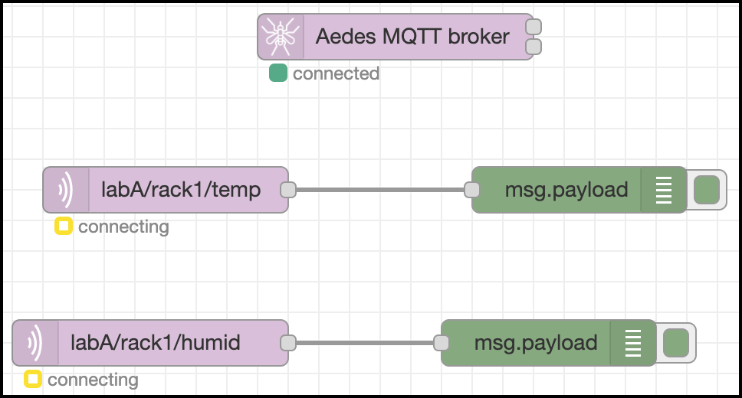
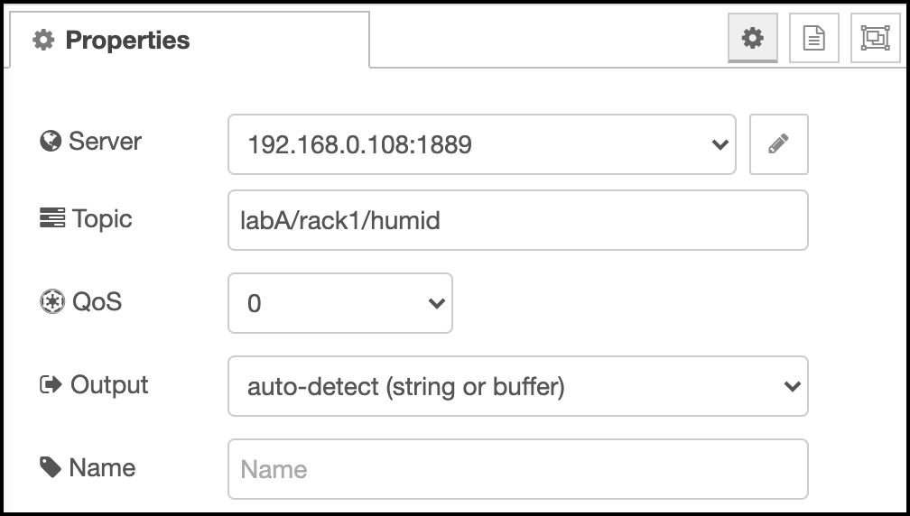
MQTT on Pi – Let’s Start
iii. Deploying Aedes Broker
Configurations:
Broker IP = 192.168.0.108*
MQTT port = 1889**
MQTT_IN = labA/rack1/temp ← node#1
MQTT_IN = labA/rack1/humid ← node#2
Download palette: https://bit.ly/3qGwyTE.
node#1
node#2
* Please check your device IP address.
** do not use 1880 – reserved to localhost:1880
SZS - Nov 2021

Slide 8
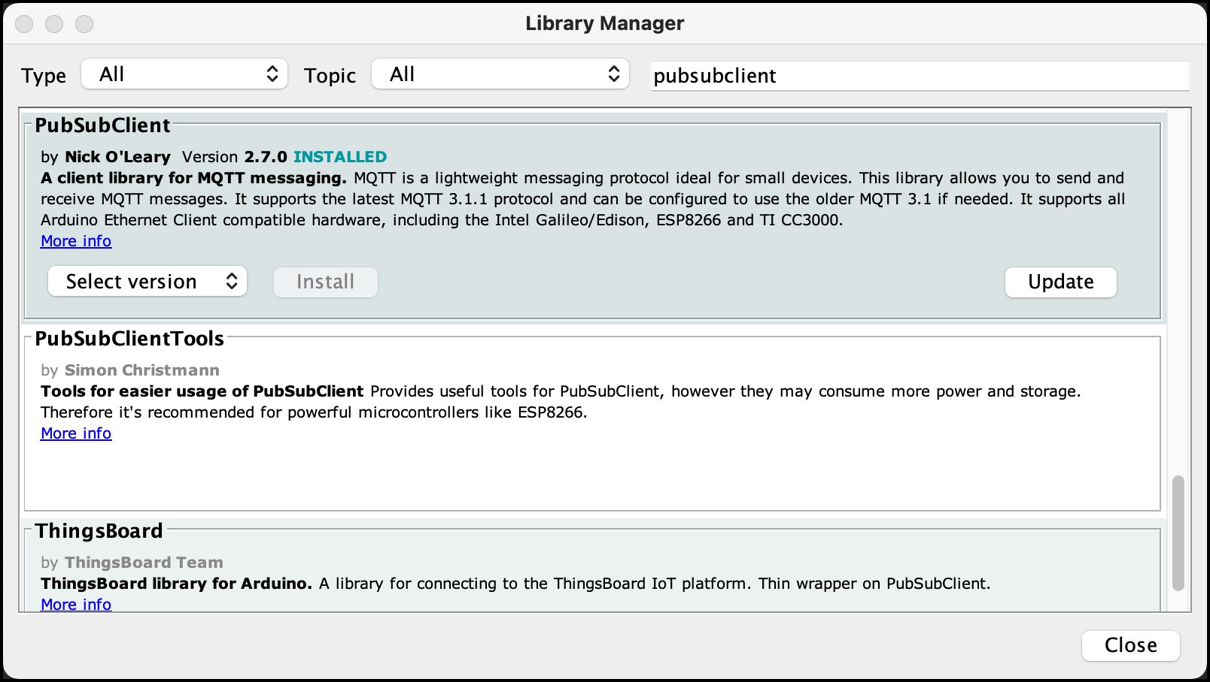
MQTT on Pi – Let’s Start
iv. Arduino Client MQTT
Install New Library by opening Library Manager and search for PubSubClient by Nick O’Leary – latest version.
Sketch > Include Library > Manage Libraries
PubSubClient
Nick O’Leary
SZS - Nov 2021

Slide 9
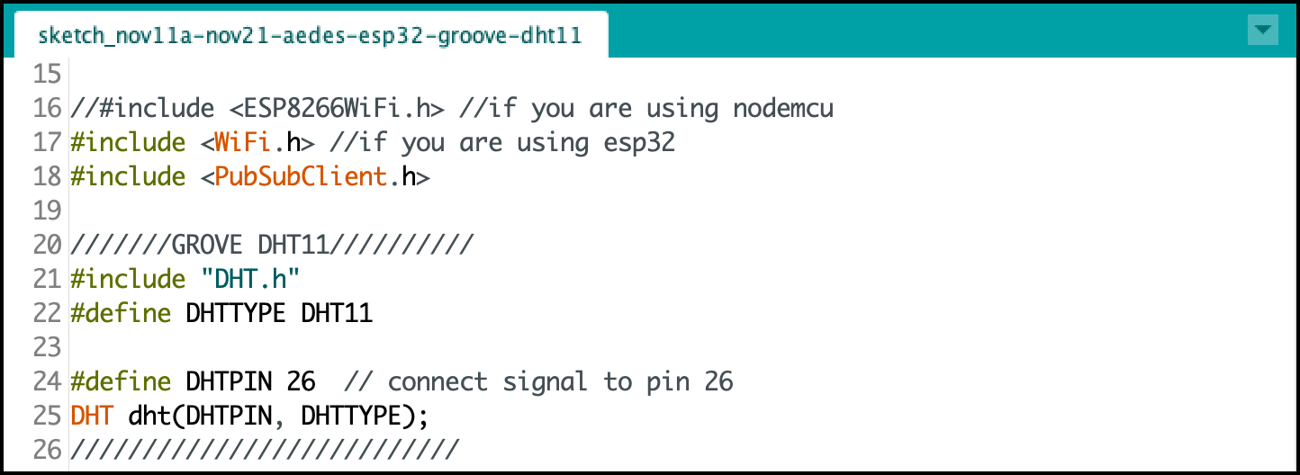
MQTT on Pi – Let’s Start
v. Arduino PubSub Sketch
Download the file working file from https://bit.ly/30dwDnb.
#16
Remove // and put // at Line#15 if you are using NodeMCU.
#17
#24
Place a jumper at signal pin to pin 26 of ESP32.
SZS - Nov 2021

Slide 10
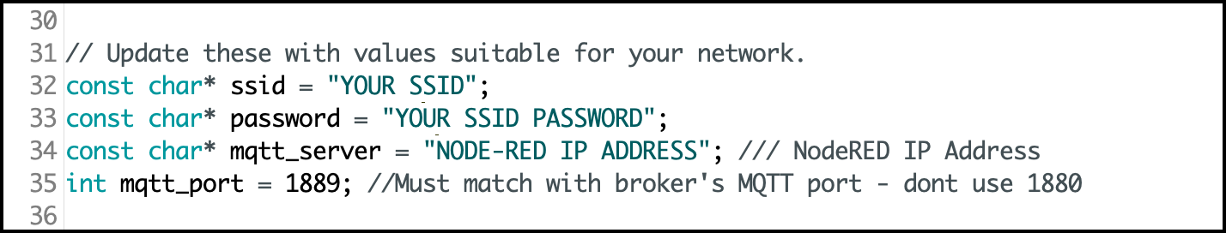
MQTT on Pi – Let’s Start
v. Arduino PubSub Sketch
Download the file working file from https://bit.ly/30dwDnb.
#32
Set your SSID & password.
#33
#34
IP address of your Node-RED device.
SZS - Nov 2021

Slide 11
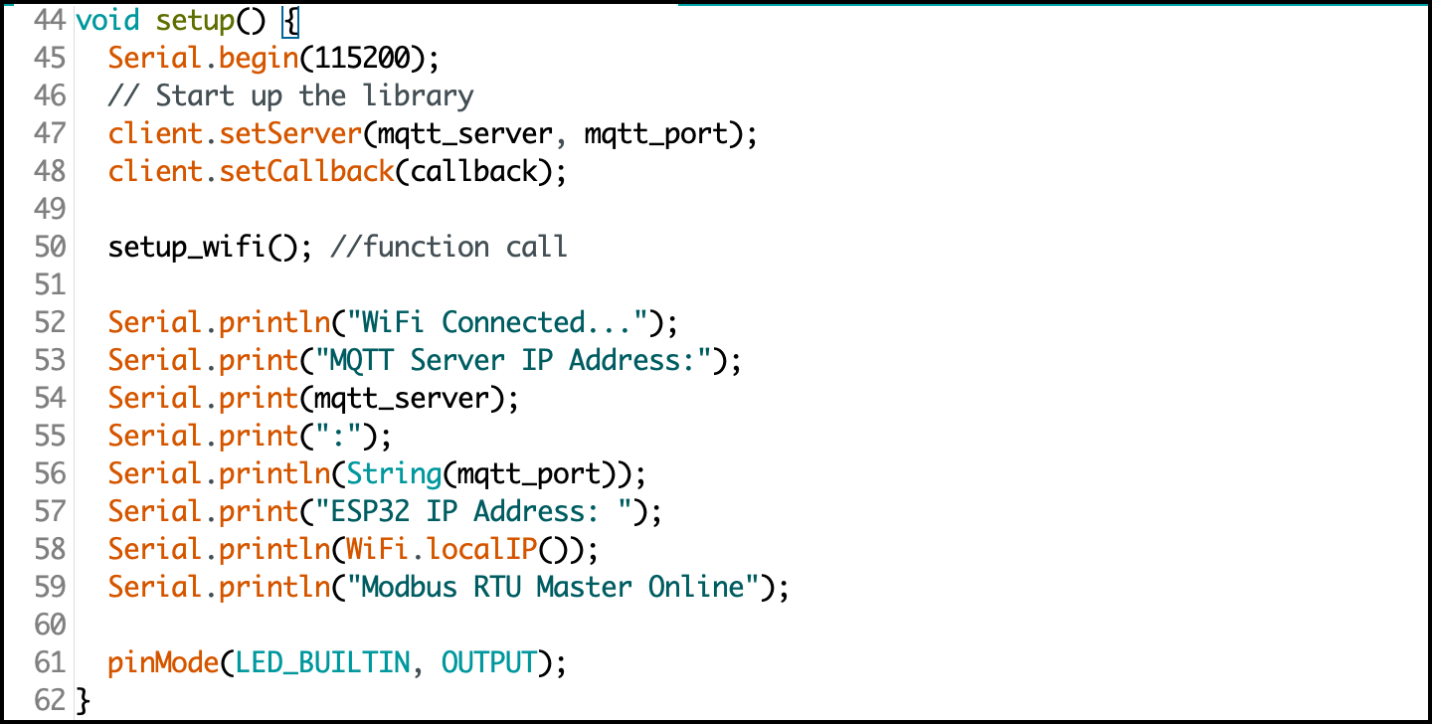
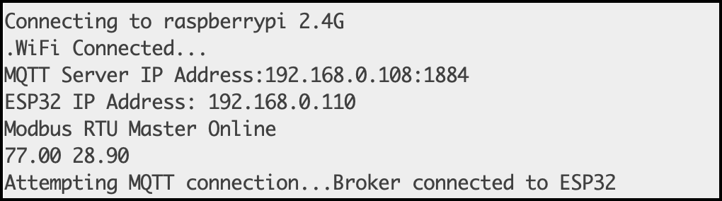
MQTT on Pi – Let’s Start
v. Arduino PubSub Sketch
Download the file working file from https://bit.ly/30dwDnb.
From Serial Monitor
#50
#52
#53
#57
#59
Reading from DHT11 sensor
SZS - Nov 2021

Slide 12
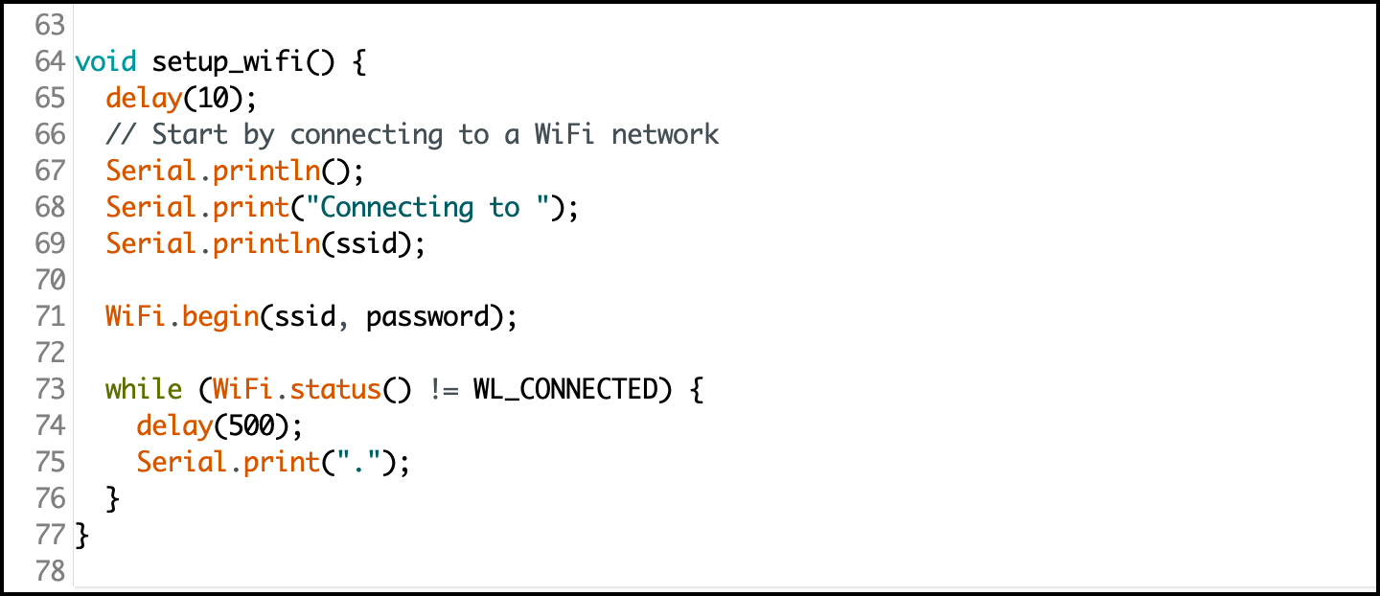
MQTT on Pi – Let’s Start
v. Arduino PubSub Sketch
Download the file working file from https://bit.ly/30dwDnb.
A function to connect the ESP32 / NodeMCU to existing access point (WiFi).
Check your SSID & password in case non-stop dotted line appears.
SZS - Nov 2021

Slide 13
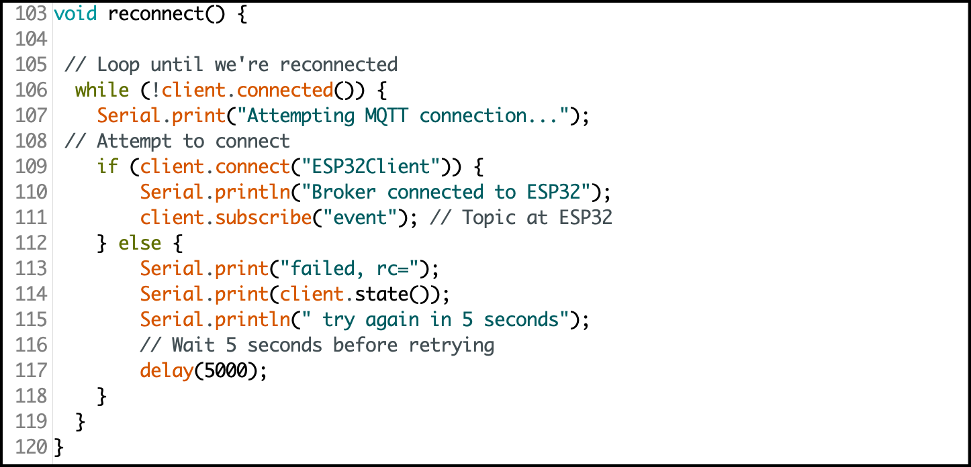
MQTT on Pi – Let’s Start
v. Arduino PubSub Sketch
Download the file working file from https://bit.ly/30dwDnb.
ESP32 @ NodeMCU ensure persistent connection between MCU and the broker.
SZS - Nov 2021

Slide 14
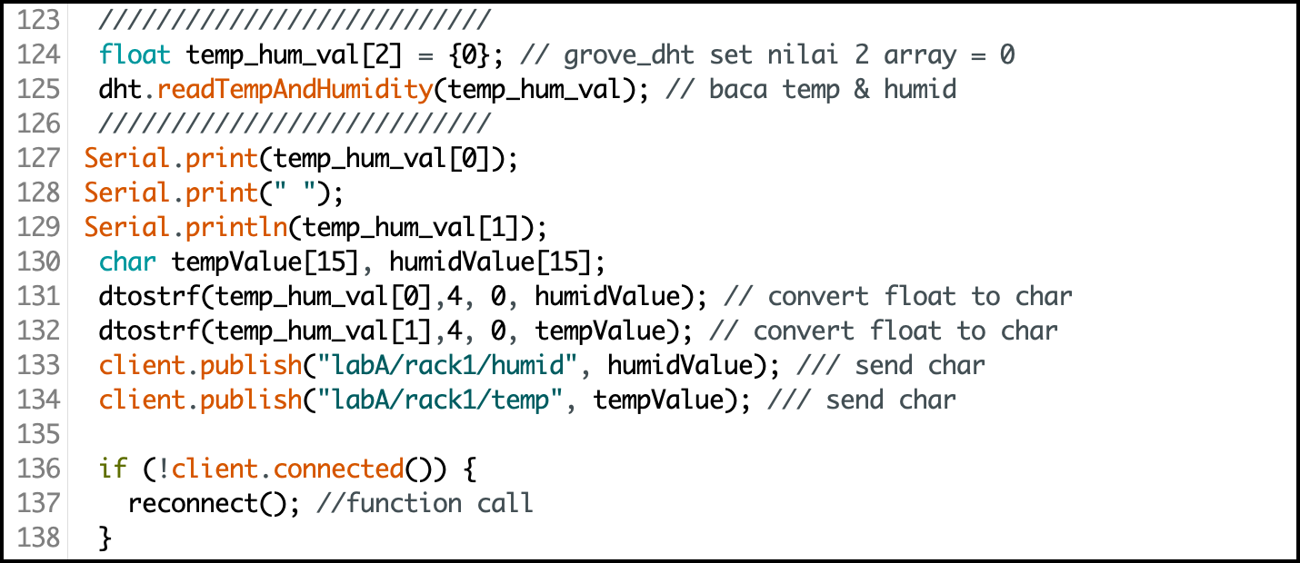
MQTT on Pi – Let’s Start
v. Arduino PubSub Sketch
Download the file working file from https://bit.ly/30dwDnb.
L#124
Set 2 array elements; temp_hum_val[0] & temp_hum_val[1]. Set both value = 0.
Start to read temp & humid from sensor.
Print both values; temp & humid at Serial Monitor.
Convert temp & humid from float to char.
Publish the temp & humid value accordingly. Topic name must match with Node-RED’s topic.
Will reconnect to broker if disconnected.
L#125
L#127
L#127
L#133
L#136
SZS - Nov 2021

Slide 15
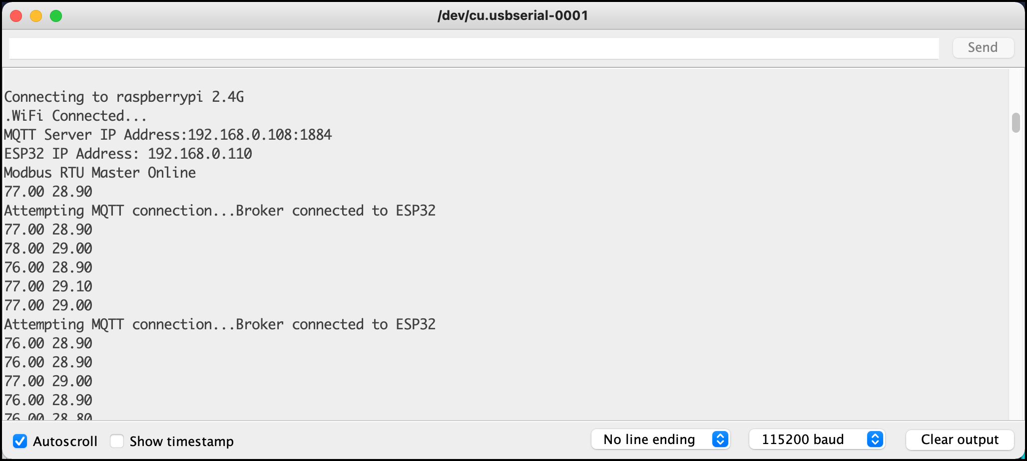
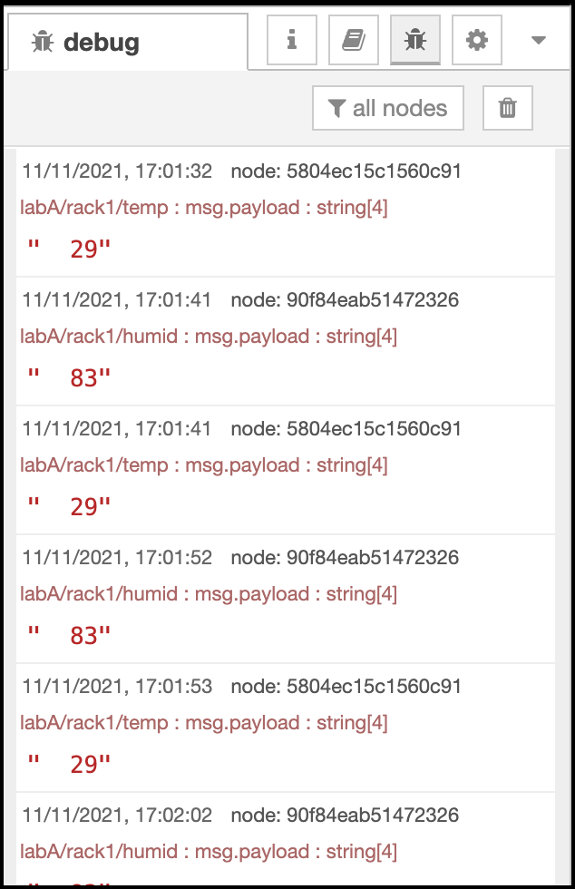
MQTT on Pi – Let’s Start
v. Arduino PubSub Sketch – Expected Output
Arduino’s Serial Monitor
Node-RED Debug Window
* Do check your IP address, Topic at your sketch if you did not get as expected
output.
SZS - Nov 2021

Slide 16
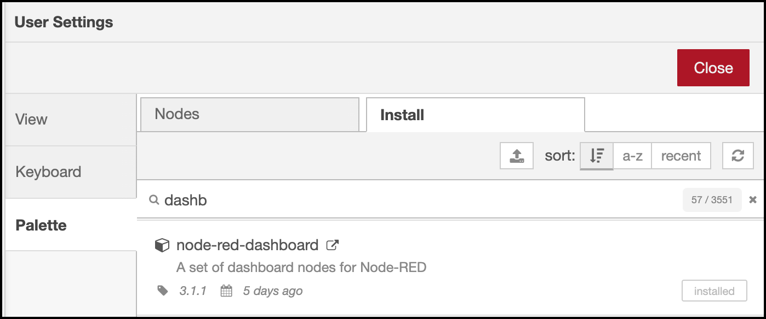
MQTT on Pi – Let’s Start
vi. Create Visual Dashboard
Go to Node-RED editor.
Install Dashboard broker by clicking:
Node-RED Menu > Manage palette > Install > type dashboard at search module > node-red-dashboard > install
SZS - Nov 2021

Slide 17
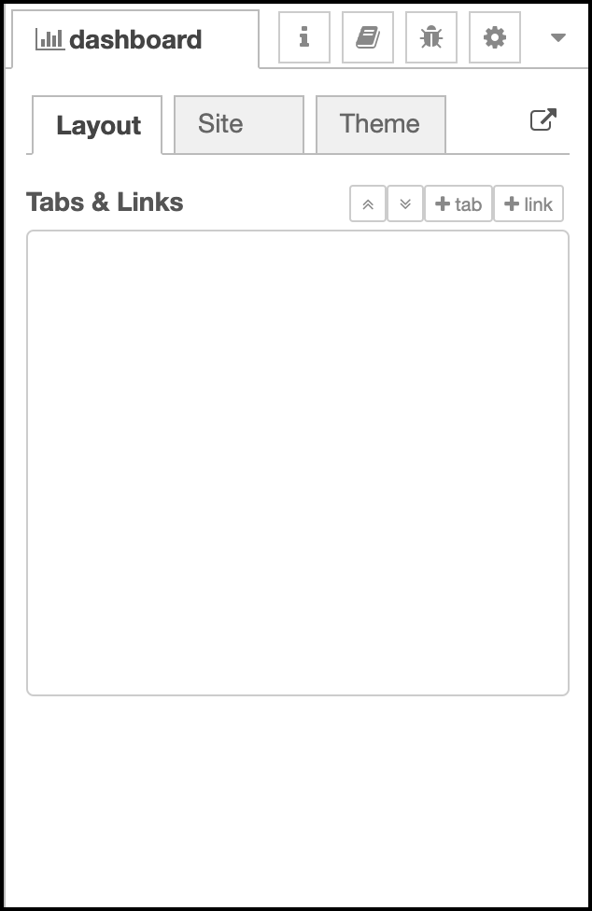
MQTT on Pi – Let’s Start
vi. Create Visual Dashboard
In order to run a Node-RED dashboard, you need to create a tab &
a group.
Decide what information that you want to display.
In our case, you should consider:
Classroom : Lab A
Rack ID: 1
Item to visual/display: Temperature & Humidity
Thus,
Tab = Main Title = Lab A
Group = Sub Title = Rack1
FYI, more than 1 group can be hosted by 1 tab.
Your tab can also host group from other tab.
SZS - Nov 2021

Slide 18
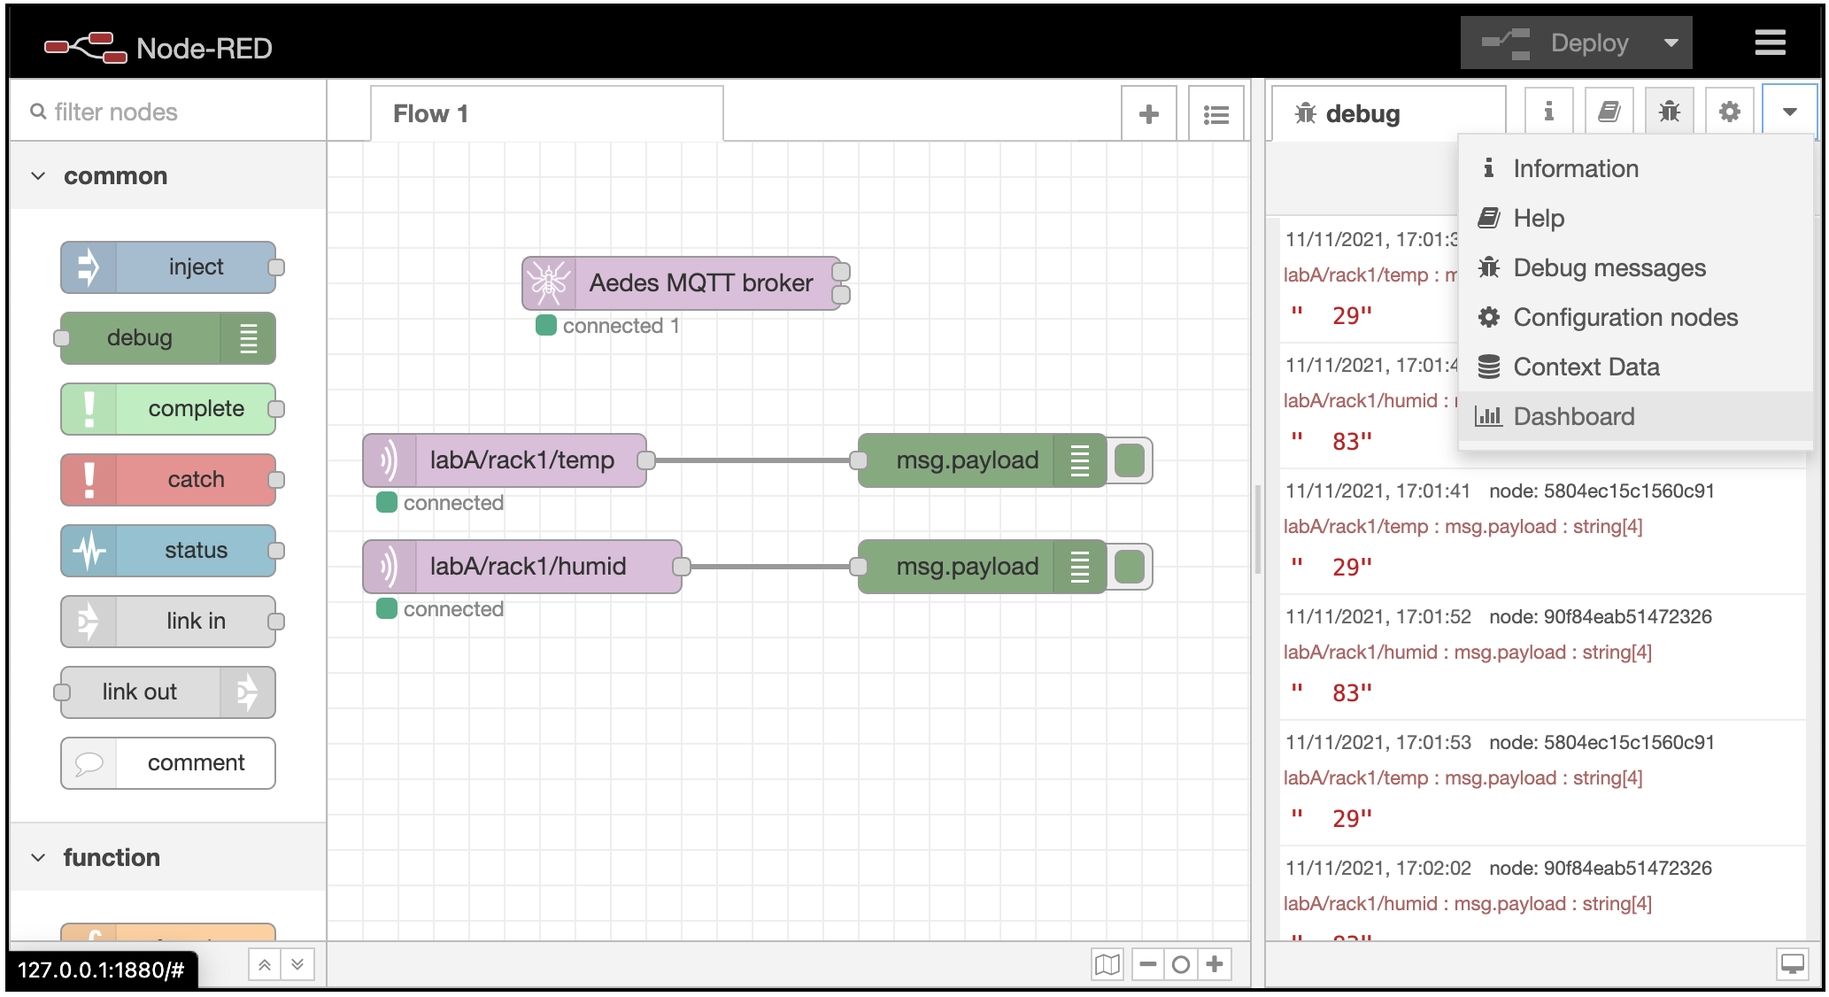
MQTT on Pi – Let’s Start
vi. Create Visual Dashboard
We need to setup dashboard properties before connecting the gauge/meter node to the flow.
Step 1: Click the dropdown Menu of Node-RED.
Step 2: Click Dashboard link.
S1
S2
SZS - Nov 2021

Slide 19
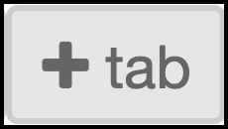


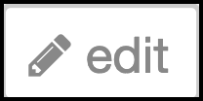
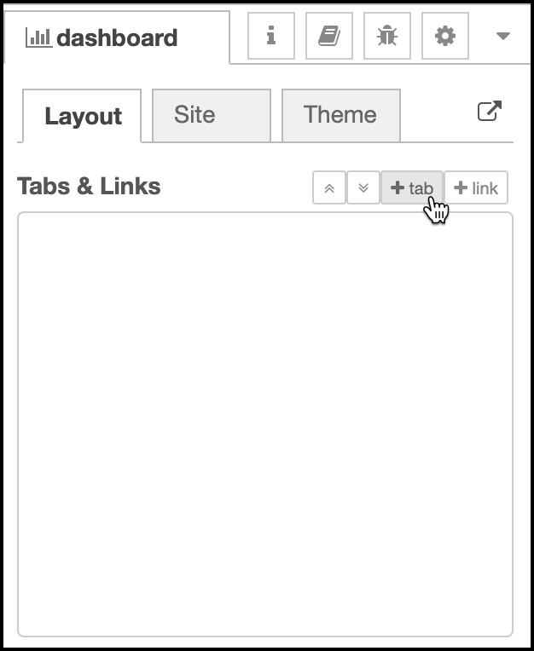
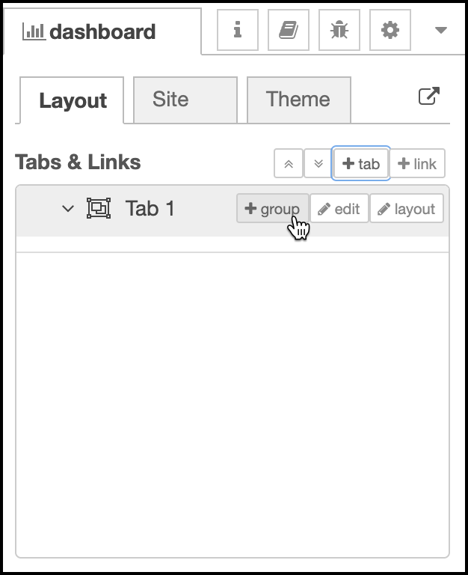
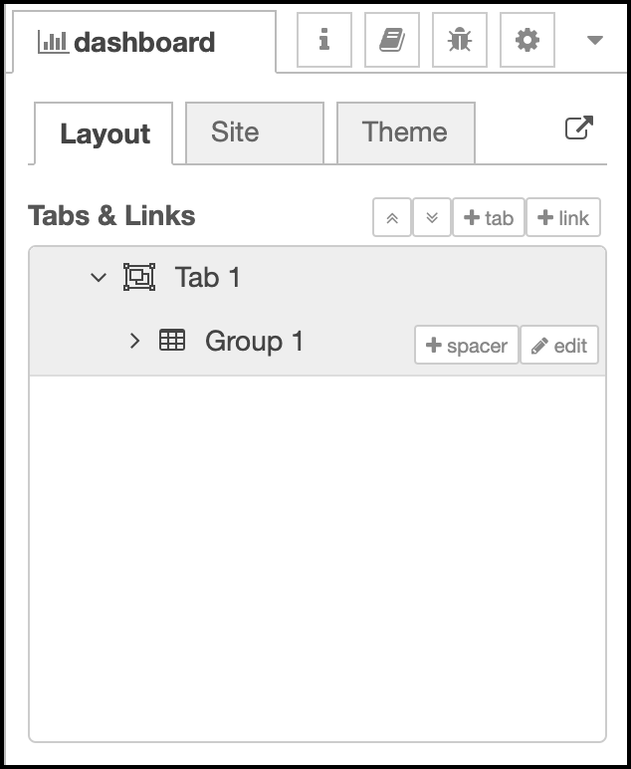
MQTT on Pi – Let’s Start
vi. Create Visual Dashboard
Step 3: Create a project by clicking .
Step 4: Add element in your project by clicking at .
You may edit/update/delete tab properties or group properties by clicking at .
S3
S4
SZS - Nov 2021

Slide 20

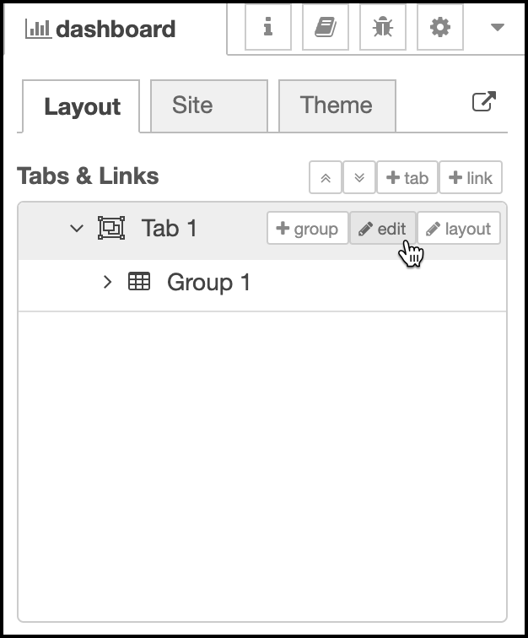
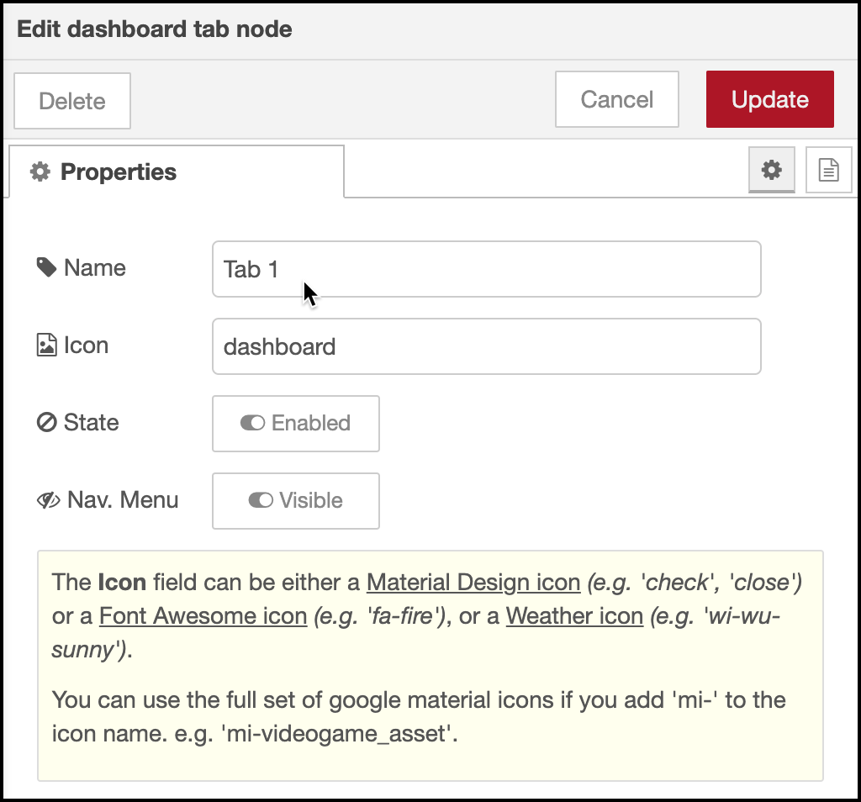
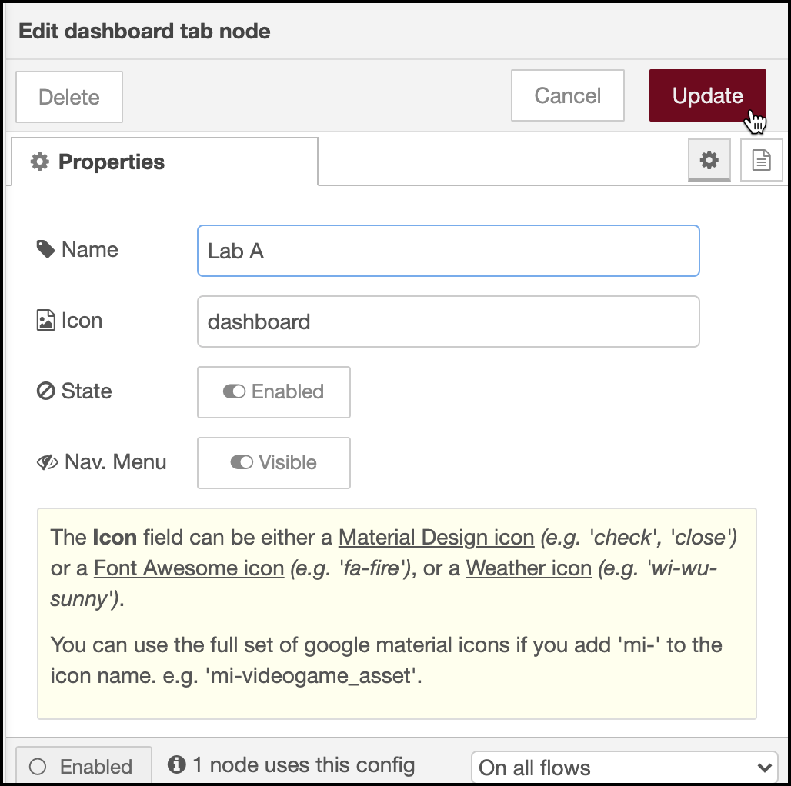
MQTT on Pi – Let’s Start
vi. Create Visual Dashboard
Step 5: Click to edit the Tab 1 name .
Step 6: Change Tab 1 with Lab A.
Step 7: Next, click to save the setting.
S7
S6
S5
Step 4
SZS - Nov 2021

Slide 21
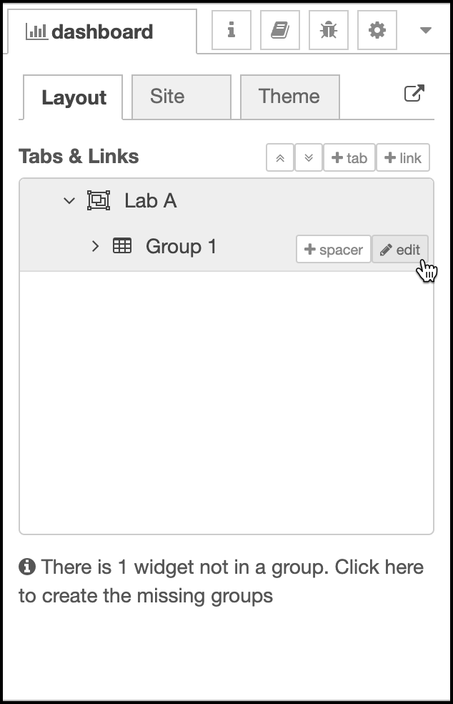
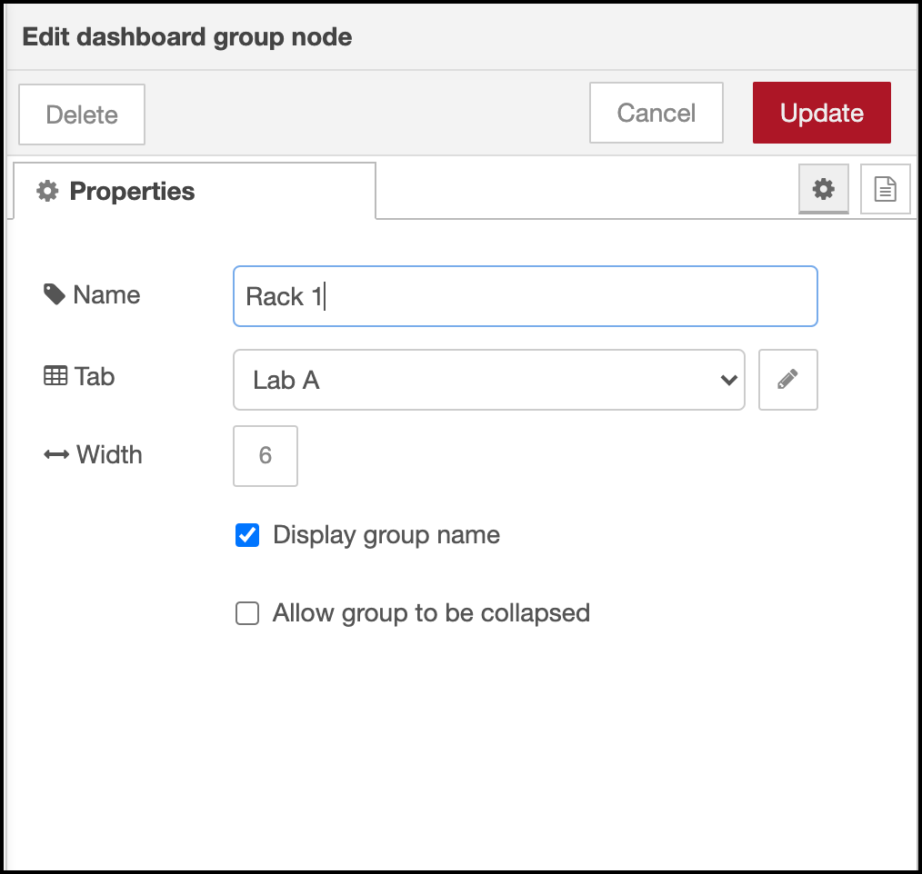
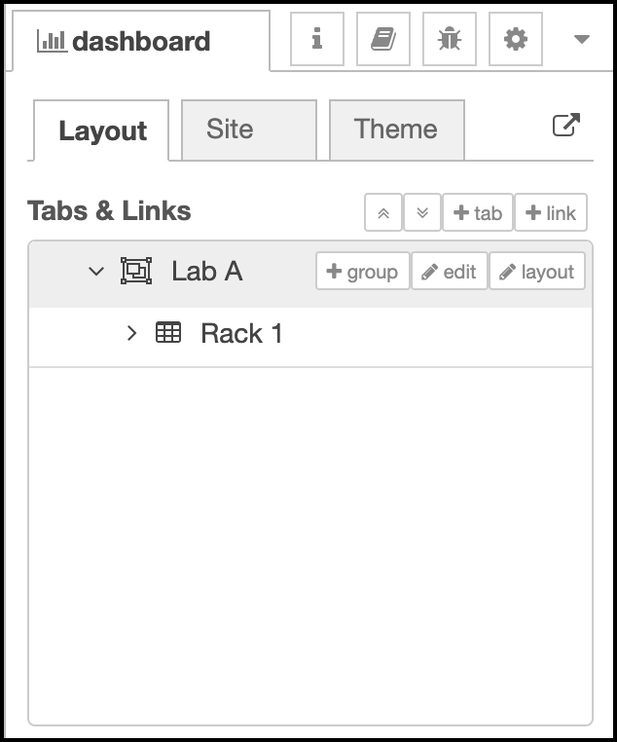
MQTT on Pi – Let’s Start
vi. Create Visual Dashboard
Step 8: Click edit tab at Group 1.
Step 9: Change Group 1 to Rack 1.
Step 10: Click Update tab to save the setting..
S10
S9
S8
SZS - Nov 2021

Slide 22
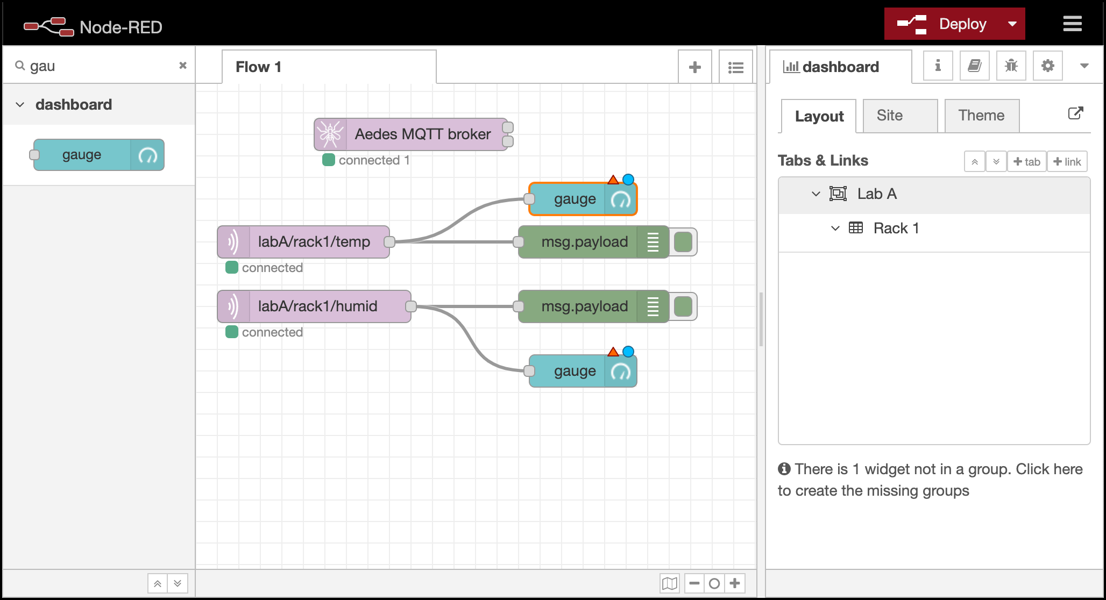
MQTT on Pi – Let’s Start
vi. Create Visual Dashboard
Step 11: Now, add 2 gauges from dashboard palette.
Step 12: Wire each gauge to labA/rack1/temp & labA/rack1/humid respectively.
Any of dashboard palette must be configured into its specific tab & group.
The chances of your node appears in different tab will happen when you mistakenly mapped the groups & tabs.
S11
S12
SZS - Nov 2021

Slide 23
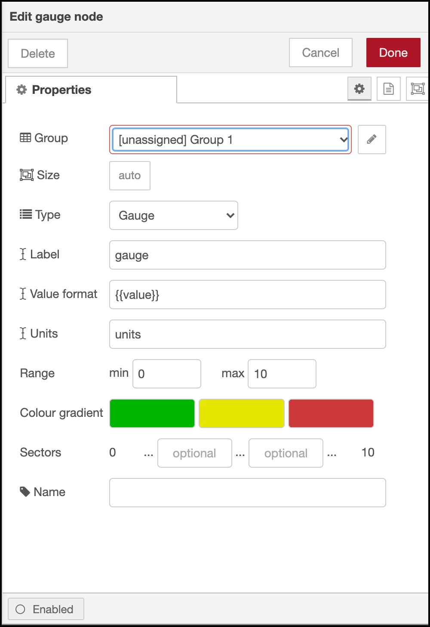
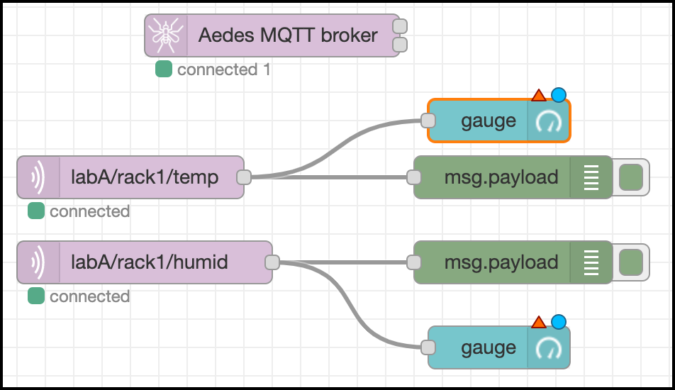
MQTT on Pi – Let’s Start
vi. Create Visual Dashboard
Configuration of Gauges.
Step 13: Double click gauge connected to labA/rack1/temp.
Step 19: Double click gauge connected to labA/rack1/humid.
**Item to change.
**
**
S13
**
**
S19
SZS - Nov 2021

Slide 24
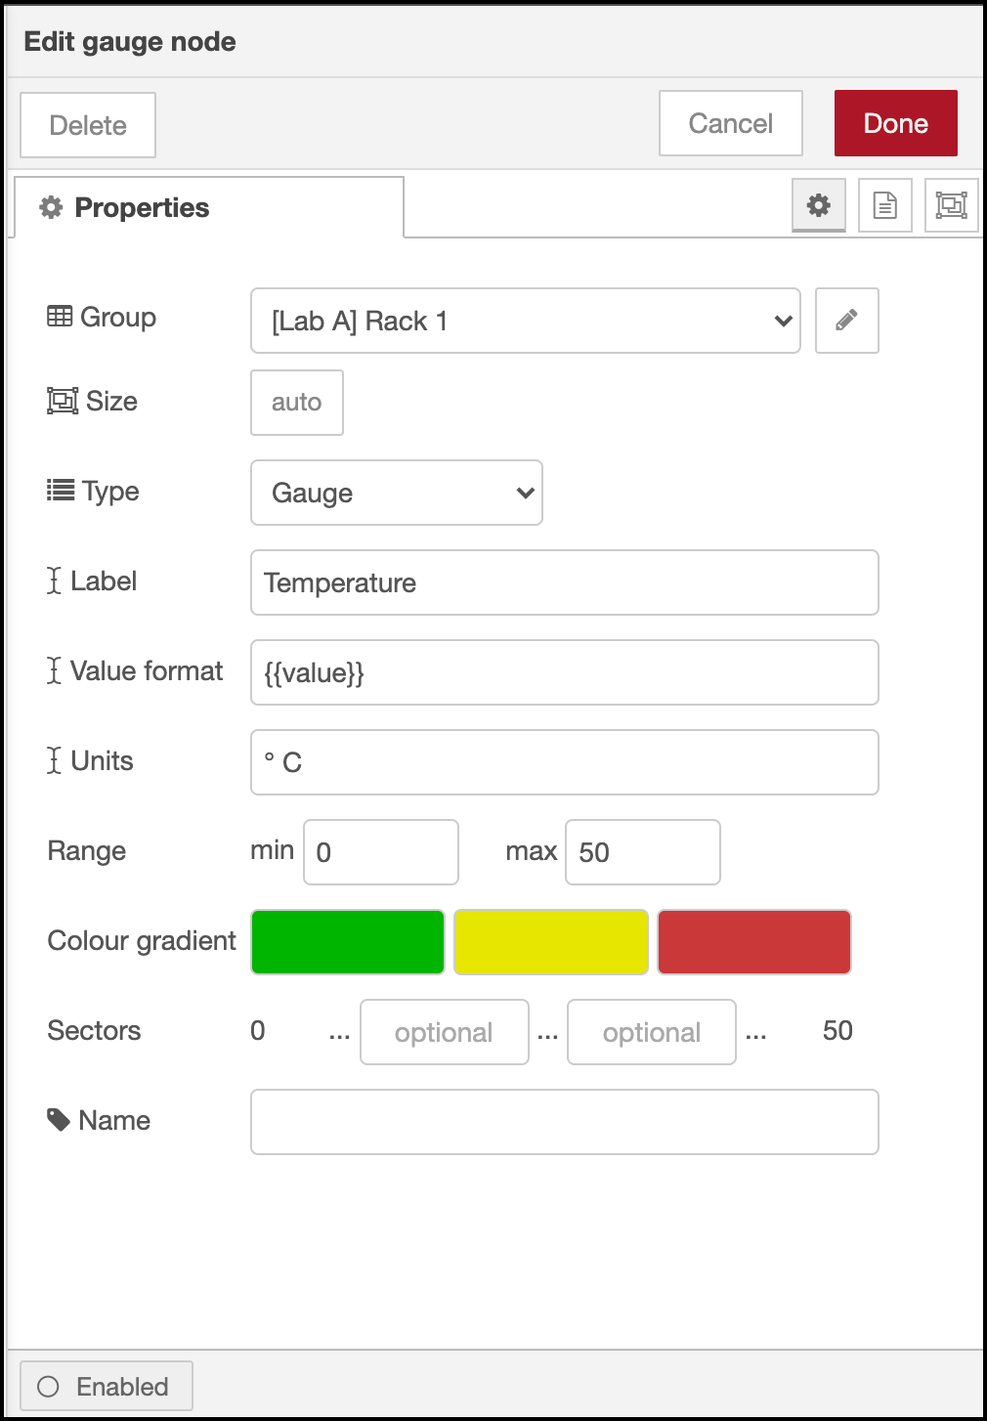
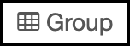
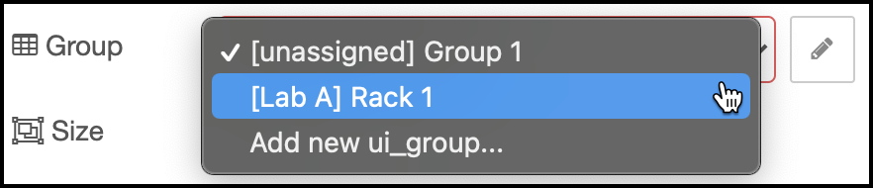

MQTT on Pi – Let’s Start
vi. Create Visual Dashboard
S18
Update Temperature Gauge Properties.
Step 14: Click textbox at . Change [unassigned] Group 1
to select [Lab A] Rack 1.
Step 15: Change text gauge to Temperature at .
Step 16: Replace units with ° C (you may copy ° here).
Step 17: Replace maximum range 10 with 50
DHT11’s range is between 0° C to 50° C.
Step 18: Click upon completion. **Item to change.
S14
S15
S16
S17
SZS - Nov 2021

Slide 25
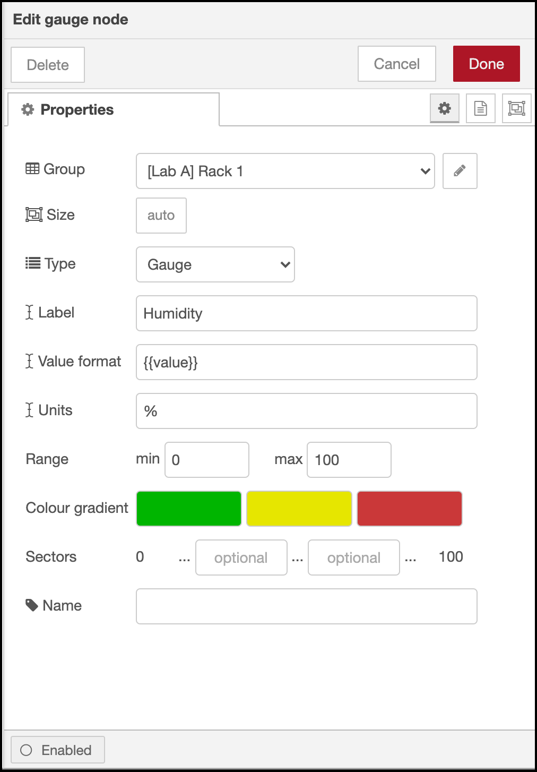
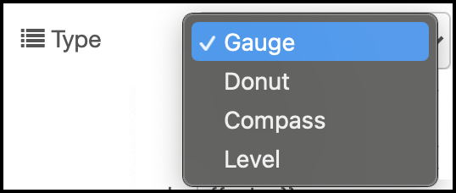
MQTT on Pi – Let’s Start
vi. Create Visual Dashboard
S24
Update Humidity Gauge Properties.
Step 20: Click textbox at . Change [unassigned] Group 1
to select [Lab A] Rack 1.
Step 21: Change text gauge to Temperature at .
Step 22: Replace units with ° C (you may copy ° here).
Step 23: Replace maximum range 10 with 50
Humidity range is between 0° C to 100° C.
Step 24: Click upon completion.
Step 25: Node-RED offers a few interactive visual for metering.
You may go to Type & select the output that suit with your needs.
Do not forget to click Deploy button.
S20
S25
S21
S22
S23
SZS - Nov 2021

Slide 26
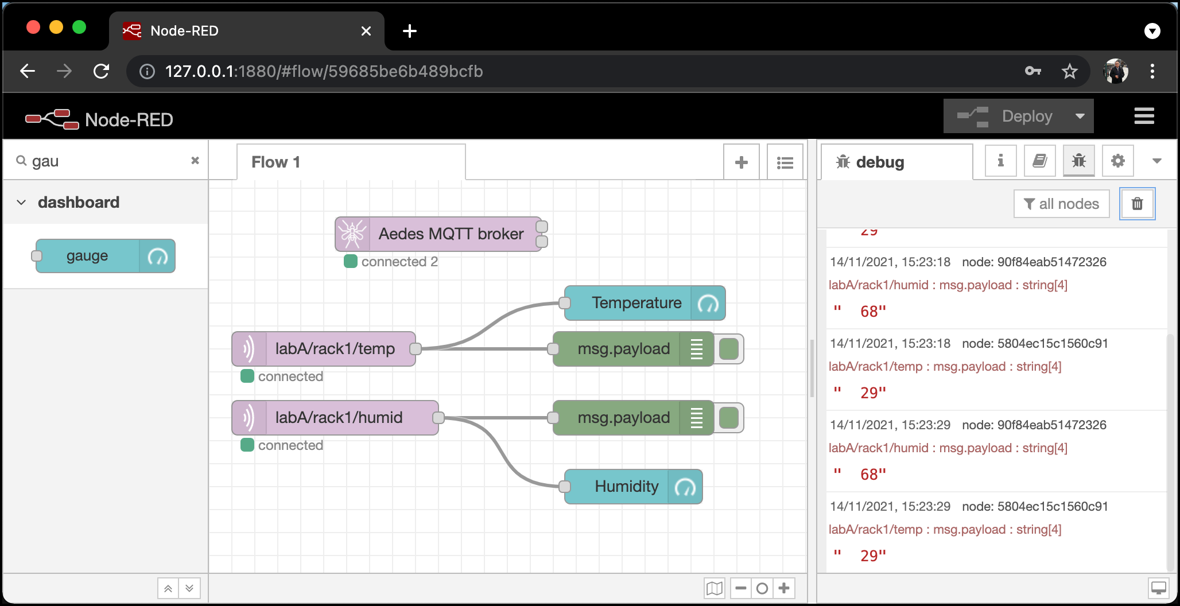
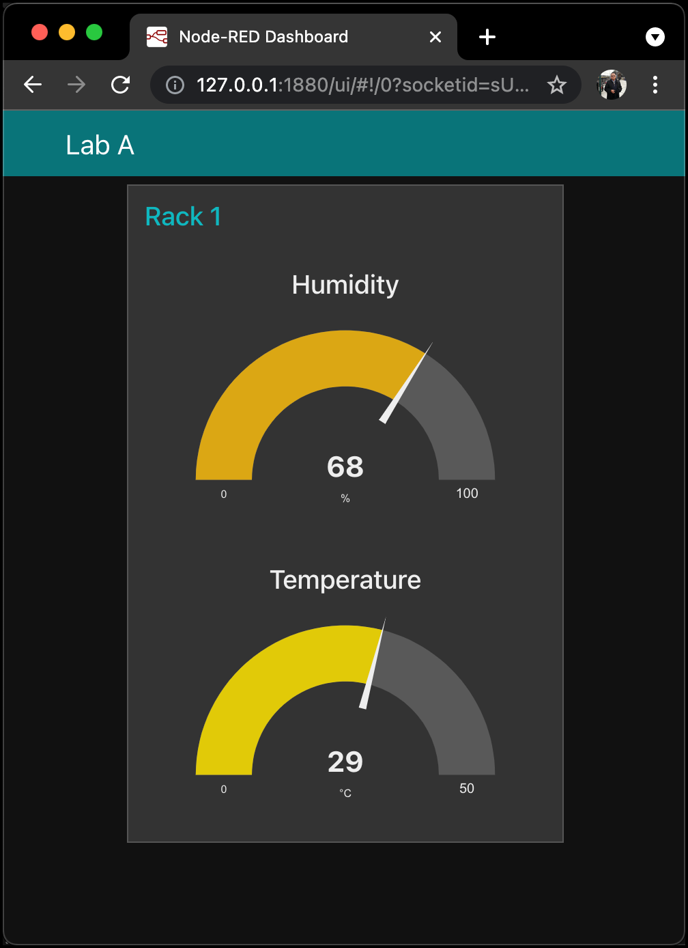
MQTT on Pi – Let’s Start
vi. Create Visual Dashboard
Download the file working file from https://bit.ly/3DfNfsI.
Node-RED Flow Editor
Node-RED Dashboard
SZS - Nov 2021

Slide 27
MQTT on Pi – Let’s Start
vi. Create Visual Dashboard
Adding More Racks.
In order to add more rack, means you have to add more sensors.
You have to consider the topic at ESP32 and also at broker side.
Assume you want to add Rack 2, Lab A. Open arduino sketch (https://bit.ly/31WQUhn) and change:
labA/rack1/humid at line number 133 to labA/rack2/humid, and also ,
labA/rack1/temp at line number 134 to labA/rack2/temp.
Next, at Node-RED flow editor, add 2 mqtt in, set IP address similar with steps, label the topic as labA/rack2/humid and labA/rack2/temp.
SZS - Nov 2021

Slide 28
QUESTIONS
END
SZS - Oct 2021

